Slide 1



Social Genome: Putting Big Data to Work for Population Informatics
Hye-Chung Kum
Texas A&M Health Science Center, Dept. of Health Policy & Management
University of North Carolina at Chapel Hill, Dept. of Computer Science
Population Informatics Research Group
(kum@tamhsc.edu)
http://research.tamhsc.edu/pinformatics

Slide 2
Who am I
PhD in computer science (data mining)
Minor: MSW (policy & management)
15+ years: CS, SW, HPM
RESEARCH FOCUS
Overarching question: How can we use the abundance of existing digital data, aka big data, (e.g. government administrative data, electronic health records) to support accurate evidence based decisions for policy, management, legislation, evaluation, and research while protecting the confidentiality of individual subjects of the data? This question focuses on the data science of using massive secondary datasets, a step before the traditional statistical methods can be applied to the data to address specific questions to improve public health.
Preferred approaches: Data Science - To build efficient and effective human computer hybrid processes and systems to clean, integrate, and extract actionable information from raw chaotic data and deliver accurate information in a timely secure manner to decision makers (e.g. researchers, policy makers, mangers, clinicians).
Population Informatics Research Group (TAMU & UNC)

Slide 3
Agenda
What is Big Data ? What is Data Science ?
What is Population Informatics & the Social Genome ?
How is Data Science different from traditional science?
Doing research with Big Data

Slide 4
Agenda
What is Big Data ? What is Data Science ?
What is Population Informatics & the Social Genome ?
How is Data Science different from traditional science?
Doing research with Big Data

Slide 5
Computer Science Perspective

Slide 6
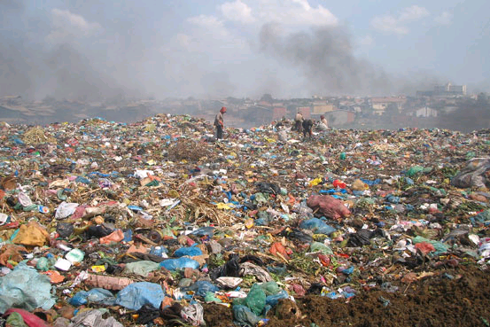


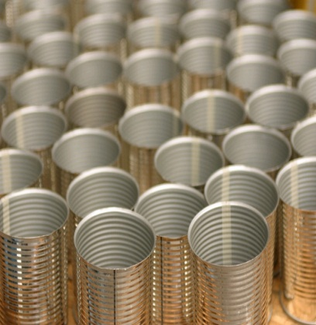

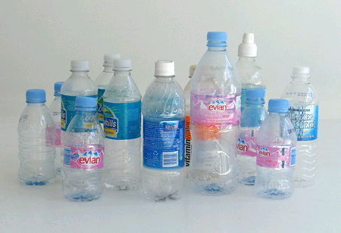
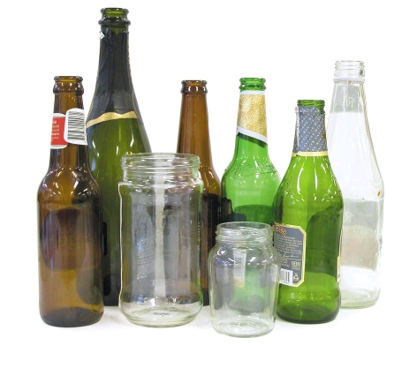
Data Science Knowledge Discovery & Data mining (KDD)
Big Data : impossible to keep organized
KDD
Clean, Merge, Reprocess
Human consumable, valid, novel, potentially useful,
and ultimately understandable information
Notes:
SIGKDD 1998

Slide 7
How different from traditional field of Database?
Traditional field DB
Initially focused on transaction DB systems to OPERATE using digital data
Recoverability, fault tolerance, trace back
E.g.: Operate a company, bank, government agency
KDD, Data Science
Now that we have all this data, how can be best use it for multiple purposes beyond initial operation?
Building a knowledge base platform
Uncertainty (error) management
Timely, accurate enough data management & analysis
Data integration (usually much bigger than one operational transaction DB), Data curation, Data discovery
Data/information/knowledge chain

Slide 8
Rank | Conferences | Field Rating | Pubs | Cita tions | Cita tions/ Pub
1 | KDD - Knowledge Discovery and Data Mining | 73 | 1212 | 22773 | 18.8
2 | ICDE – Int’l Conference on Data Engineering | 65 | 2370 | 23316 | 9.8
3-4 | CIKM - International Conference on Information and Knowledge Management | 43 | 1840 | 11558 | 6.3
3-4 | ICDM - IEEE Int’l Conference on Data Mining | 43 | 2241 | 11368 | 5.1
5 | SDM - SIAM Int’l Conference on Data Mining | 39 | 611 | 6701 | 11.0
6 | PKDD - Principles of Data Mining and Knowledge Discovery | 27 | 634 | 3719 | 5.9
7 | PAKDD - Pacific-Asia Conference on Knowledge Discovery and Data Mining | 23 | 929 | 3106 | 3.3
8 | WSDM - Web Search and Data Mining | 19 | 195 | 1482 | 7.6
9-10 | DASFAA - Database Systems for Advanced Applications | 18 | 868 | 2297 | 2.6
9-10 | ICWSM - International Conference on Weblogs and Social Media | 18 | 223 | 997 | 4.5
KDnuggets
http://www.kdnuggets.com/2013/11/top-conferences-data-mining-data-science.html

Slide 9
Other related fields
IEEE big data conference
Information Science (ontology, data curation)
HCI (CHI): Human computer Interaction
Machine Learning/AI
NLP
Bioinformatics: genomic data
Medical Informatics
American Medical Informatics Association
Spring AMIA (SF)
Fall annual symposium AMIA
vendors
Journal AMIA
Information Science
Electrical Engineering
Computer Science

Slide 10
More general/common Perspective

Slide 11
Properties of BIG DATA : 4V
Volume : lots of data
Velocity : constantly generating & changing
Variety : expressed in many ways
Veracity : lots of errors
(Value)
EXAMPLE: the INTERNET!
What do you do to find information/knowledge on the Internet?

Slide 12
Finding actionable information on the Internet
Figure out your question (refine as you find out more)
Descriptive: what is X?
Hypothesis: Does X do Y?
Ontology/Taxonomies: Knowledge representation about the world (synonyms, relationship between concepts)
Information integration
Triangulation / validation
Map: Zoom In / Zoom Out

Slide 13
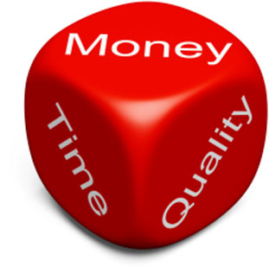
The Big Data Problem – Nutshelled Michael Franklin (UC Berkley)
Something’s
gotta
give:
Time
Quality
Money
Massive Diverse and Growing
Data

Slide 14
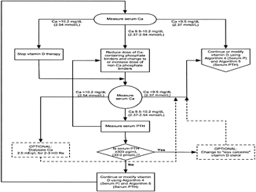
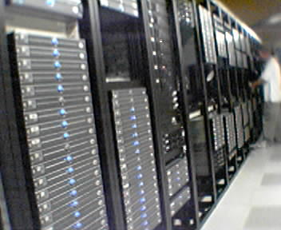

AMPLab: Integrating Three Key Resources
Algorithms
Machine Learning, Statistical Methods
Prediction, Business Intelligence
Machines
Clusters and Clouds
Warehouse Scale Computing
People
Crowdsourcing, Human Computation
Data Scientists, Analysts

Slide 15
NIST Big Data Public Working Group (NBD-PWG)
NIST: National Institute of Standards and Technology (HIPAA security standard)
Leaders of activity
Wo Chang, NIST
Robert Marcus, ET-Strategies
Chaitanya Baru, UC San Diego
http://bigdatawg.nist.gov/home.php

Slide 16
NBD-PWG Subgroups & Co-Chairs
Requirements and Use Cases SG
Geoffrey Fox, Indiana U.; Joe Paiva, VA; Tsegereda Beyene, Cisco
Definitions and Taxonomies SG
Nancy Grady, SAIC; Natasha Balac, SDSC; Eugene Luster, R2AD
Reference Architecture SG
Orit Levin, Microsoft; James Ketner, AT&T; Don Krapohl, Augmented Intelligence
Security and Privacy SG
Arnab Roy, CSA/Fujitsu Nancy Landreville, U. MD Akhil Manchanda, GE
Technology Roadmap SG
Carl Buffington, Vistronix; Dan McClary, Oracle; David Boyd, Data Tactic

Slide 17
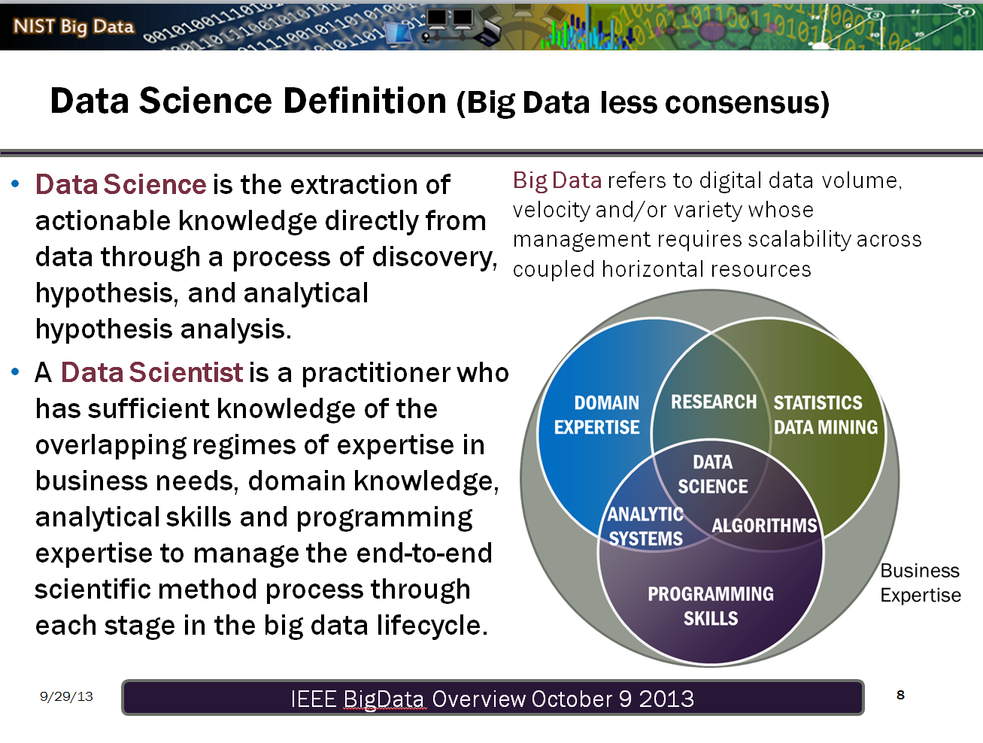

Slide 18
NIH: Big Data to Knowledge (BD2K)
http://bd2k.nih.gov/
NIH Names Dr. Philip E. Bourne First Associate Director for Data Science
December 9, 2013
NIH commits $24 million annually for Big Data Centers of Excellence
July 22, 2013
Bioinformatics – DNA/RNA data
http://grants.nih.gov/grants/guide/rfa-files/RFA-HG-14-020.html

Slide 19
NIH Definition
The term 'Big Data' is meant to capture the opportunities and challenges facing all biomedical researchers in accessing, managing, analyzing, and integrating datasets of diverse data types [e.g., imaging, phenotypic, molecular (including various '–omics'), exposure, health, behavioral, and the many other types of biological and biomedical and behavioral data] that are increasingly larger, more diverse, and more complex, and that exceed the abilities of currently used approaches to manage and analyze effectively.
Data Scientist: Development of a sufficient cadre of researchers skilled in the science of Big Data, in addition to elevating general competencies in data usage and analysis across the behavioral research workforce.

Slide 20
NIH: 4 Big Data Issues
Data Compression/Reduction
Data Compression refers to the algorithm-based conversion of large data sets into alternative representations that require less space in memory. Data Reduction refers to the reduction of data volume via the systematic removal of unnecessary data bulk.
Data Visualization
Data Visualization refers broadly to human-centric data representation that aids information presentation, exploration, and manipulation. This is typically performed via the use of visual and graphical techniques; however, these can be augmented with sound and other sensory cues to create deeper experiences.
SEE the DATA: Zoom In / Zoom Out (mapquest)
Data Provenance (replicable science – tractable processes)
Data Provenance refers to the chronology or record of transfer, use, and alteration of data that documents the reverse path from a particular set of data back to the initial creation of a source dataset. Provenance of digital scientific data is useful for determining attribution, enabling data citation, identifying relationships between objects, tracking back differences in similar results, guaranteeing the reliability of the data, and to allow researchers to determine whether a particular dataset can be used in their research by providing lineage information about the data.
Good programming practice
Data Wrangling (data cleaning/integration)
Data Wrangling is a term that is applied to activities that make data more usable by changing their form but not their meaning. Data wrangling may involve reformatting data, mapping data from one data model to another, and/or converting data into more consumable forms.

Slide 21
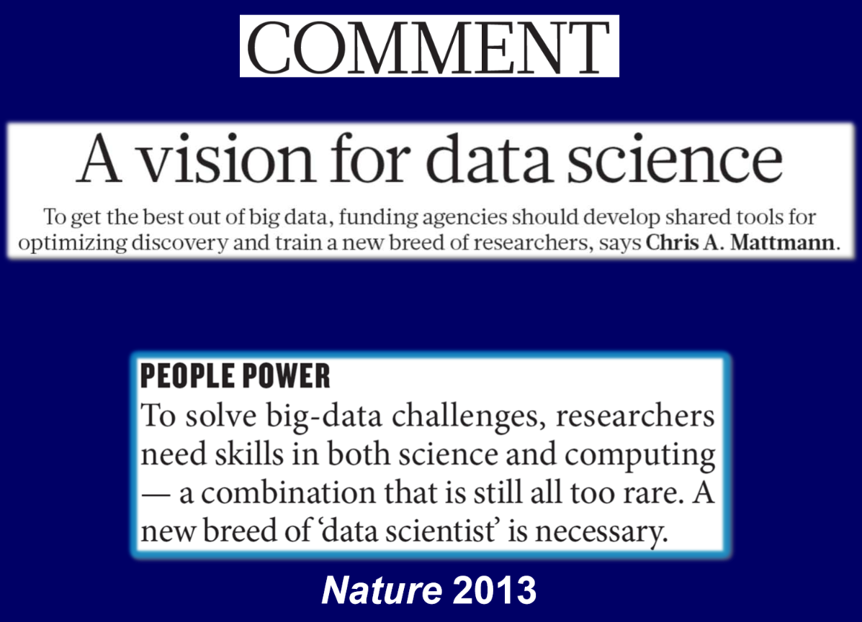
NIH and Biomedical “Big Data” http://acd.od.nih.gov/Big-Data-to-Knowledge-Initiative.pdf

Slide 22
Thomas Davenport Competing on Analytics
Skill set for good data scientists
IT & Programming skills
Statistical skills
Business skills:
Understand pros/cons of decisions & actions
Communication skills
Excel / PowerPoint
Intense curiosity: the most important skill or trait. “a desire to go beyond the surface of a problem, find the question at its heart, and distill them into a very clear set of hypothesis that can be tested”

Slide 23
Data science teams need people with the skills and curiosity to ask the big questions (oreilly)
Technical expertise: the best data scientists typically have deep expertise in some scientific discipline.
Curiosity: a desire to go beneath the surface and discover and distill a problem down into a very clear set of hypotheses that can be tested.
Storytelling: the ability to use data to tell a story and to be able to communicate it effectively.
Cleverness: the ability to look at a problem in different, creative ways.
Health is a very important domain
Team lead: good questions, good interpretation & implications
http://radar.oreilly.com/2011/09/building-data-science-teams.html

Slide 24
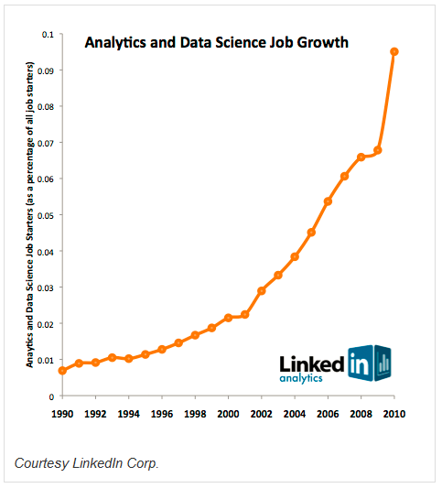
Job market of data scientists
statisticians will be the next sexy job
Google Chief Economist Hal Varian
shortage of 190,000 data scientists by the year 2019
McKinsey Global Institute

Slide 25
New Era in Science : Big Data Science
Data is the new raw material of business: an economic input almost on par with capital and labor.(Microsoft’s Craig Mundie)
Those who can harness the power of data will lead the next century and drive innovation in commerce, scientific discovery, healthcare, finance, energy, government, and countless other fields.
Students who learn to be a data science will be in high demand.

Slide 26
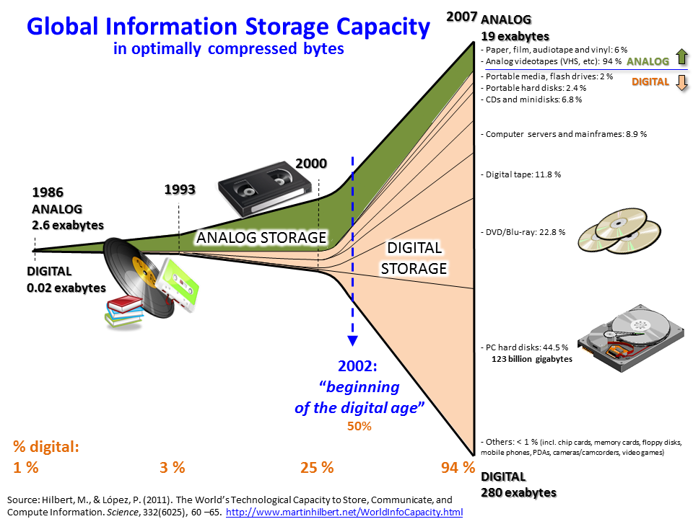

Slide 27
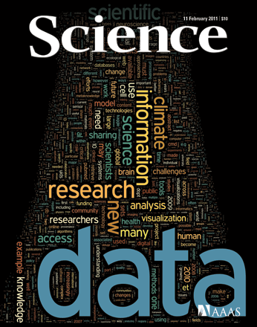
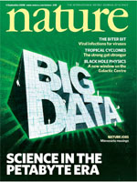
High International Interest Doing Good Research with Big Data
Figuring how to do good research with Big Data
EUDAT (Oct 2011): EU
€16-million initiative to develop an international data management infrastructure over 3 years
White house (Mar 2012) : US
a national effort to fund Big Data research across the federal agencies including NSF, NIH, DOD (Dept of Defense), and DOE (Dept of Energy)
Notes:
Sci : 2011, nature 2008 sep

Slide 28

Notes:
Hi, my name is Hye-chung.

Slide 29
Agenda
What is Big Data ? What is Data Science ?
What is Population Informatics & the Social Genome ?
How is Data Science different from traditional science?
Doing research with Big Data

Slide 30
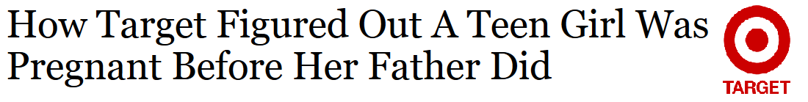
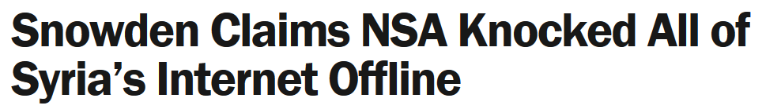
The Cost of the Digital Society
There is no turning back !
Personal information is already being used
Marketing: Target
Intelligence: Edward Snowden
Notes:
there is NO turning back…this is a digital world, and the information is out there… personal information is already being used for undesirable purposes with no transparency or control. We have already paid the cost of the digital society. Target and NSA know about you.

Slide 31

Why not reap the benefits too ?
Allocations of resources for education
What is the long term impact of moving to managed care ?
What effect does teacher pay in middle school have on college grades?
The answers could easily be derived from relevant data sets
Notes:
Isn’t it time we reap the benefits from big data as well?
The ability to answer questions about human populations in near real time using distributed datasets that are large, complex, and diverse has the potential to transform social, behavioral, economic, and health sciences.
The results could lead to more informed and effective policy decisions and allocations of public resources.
We can easily derive the answer to questions like ‘What is the long term impact of headstart?’ or What effect does teacher pay in middle school have on college grades?
from relevant datasets.
But it has to be done in the right way.

Slide 32
The Problem
Higher privacy standard and accountability
Difficult to access: Privacy/confidentiality
No neutral safe place to put it together
Requires more accurate results compared to recommending books
Error management
Lack Data management tools and expertise
Difficult to integrate: silo/scattered data
Difficult to clean data
Notes:
Research is and should be held to a higher ethical standard.
It also requires more accurate results than is acceptable when recommending books.
So far, challenges associated with maintaining privacy and confidentiality, data access, integration, and management and error management have constrained the use of person-level data in these areas of research, leaving rich databases largely untapped.

Slide 33
The Power of the Social Genome

Our activities from birth until death leave digital traces in large databases

Digital traces capture our social genome, the footprints of our society

The social genome data are buried in the massive and chaotic data

It holds crucial insights into many of the most challenging problems facing our society (e.g. healthcare, education, economics)
Notes:
Social scientists have long drawn on data collections from governments and elsewhere to track demographic trends such as inflation and employment rates. However, now in the digital era, our daily activities from birth until death leave digital crumbs all over cyberspace,
Collectively, these digital traces—across a group, town, county, state, or nation—form a population’s social genome, the collective footprints of our society.
and we have the technology to gather and analyze these crumbs to obtain crucial insights into the most challenging problems in society such as healthcare, economics, and education.

Slide 34
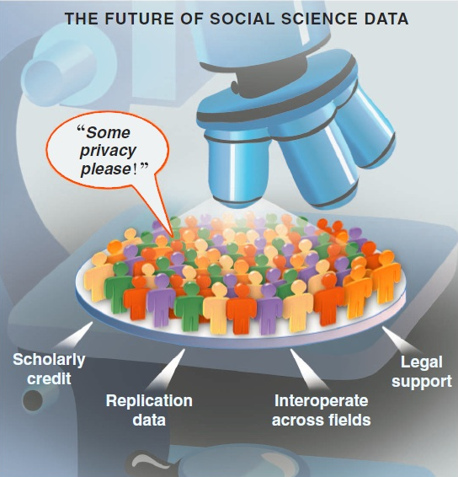
The Impact: Population Informatics
Game changing research
Transform health and social sciences
Major impact on public policy and management
Easier and safer access to better data and tools
Improved security of sensitive data already on campus
Improved integration of data
At the price of running a public library
Source: Gary King. Ensuring the Data-Rich Future of the Social Sciences, Science, vol 331, 2011, pp 719-721.
Kum, H.C., Krishnamurthy A., Machanavajjhala A., and Ahalt S. Social Genome: Putting Big Data to Work for Population Informatics. IEEE Computer Special Outlook Issue. Jan 2014
Notes:
Social genome data can tell us about how people live, work, respond to change, and make decisions, and most importantly the collective impact of these individual decisions. Such insights help us understand the root causes of social and public health problems, predict the downstream effects of different policy options, and allocate our collective resources for the greatest impact.
Just as bioinformatics has revolutionized biological research, population informatics could catalyze significant advances in our understanding of trends in society, health, and human behavior.
Never before in history have we had more data to use for population research, however, privacy and confidentiality protection is critical to the success of population informatics research.
--------------------
Population informatics is the burgeoning field at the intersection of social sciences, health sciences, computer science, and statistics that applies quantitative methods and computational tools to answer questions about human populations.

Slide 35
Actionable
Policy and Practice
Data Savvy
Managers
(Decision Makers)
Data Based Answers to
Real world Problems
Transformational Knowledge
Secure Federated Data Infrastructure
Federated administrative data, Linkable survey microdata
Other (Blog, Private company data, etc.)
Information
Broad new research Questions
Data Intensive
Domain Scientists
Frame Real World Questions
to Tractable Questions
Domain Knowledgeable
Computer Scientists
Methods
Datamining, Machine learning,
Artificial intelligence, Statistical methods, ABM
Social Genome Data Library
Population Informatics: The systematic study of populations via secondary analysis of massive data collections (“big data”) about people.
Kum, H.C., Krishnamurthy A., Machanavajjhala A., and Ahalt S. Social Genome: Putting Big Data to Work for Population Informatics. IEEE Computer Special Outlook Issue. pp 56-63. Jan 2014

Slide 36
Homework for computer scientists
How can we run a good public social genome library?
Secure data access
Usable system for non computer savvy people (social scientists, statisticians)
“legally” compliant system
Reasonably cost

Slide 37
Datawarehouse?
Knowledge base synthesis vs typical ETL (extract-transform-load) tools available for data warehousing
Knowledge base synthesis
from multiple domains
maintain multiple versions of the data
to satisfy the disparate information needs of multiple users (tenant)
Multiple purposes

Slide 38
Knowledge base platform
Goals of the typical ETL process
maintain one clean collection of data for operation
Approach for knowledge base platform
Abstract out domain-independent algorithms into a platform layer
expose a set of plug-ins that different users can customize for knowledge base synthesis.
It is important that such plug-ins can support efficient human decision making by quickly pointing out inconsistencies that need to be resolved in the federated data
along with interactive visualization that supports multiple levels of details.
K. Bellare et al., “WOO: A Scalable and Multi-Tenant Platform for Continuous Knowledge Base Synthesis,” VLDB Endowment, vol. 6, no. 11, 2013, pp. 1114–1125.

Slide 39
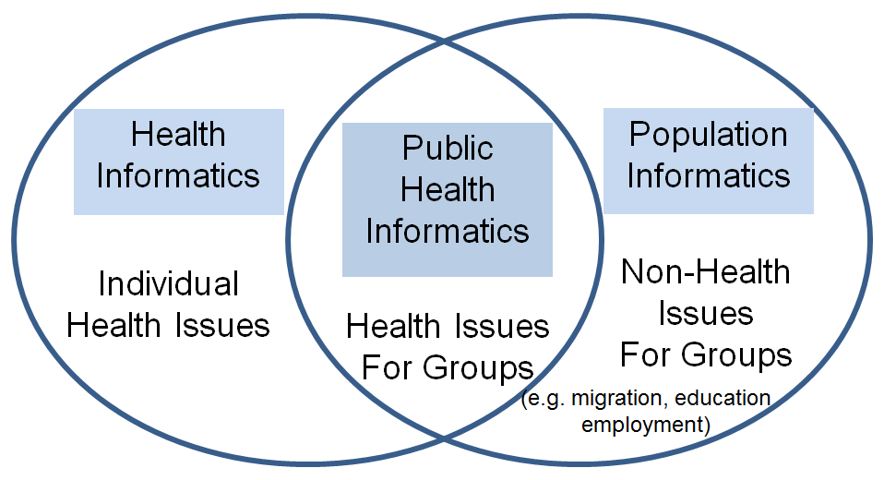
Population Informatics ?
The systematic study of populations via secondary analysis of massive data collections (termed “big data”) about people.
Kum, H.C., Krishnamurthy A., Machanavajjhala A., and Ahalt S. Social Genome: Putting Big Data to Work for Population Informatics. IEEE Computer Special Outlook Issue. Jan 2014
North Carolina
Child Welfare
Medicaid
TANF
SNAP (foodstamps)
Income (UI)
Education
Juvenile Justice
Notes:
Public health informatics=population informatics

Slide 40
LEHD : US Census Burea
Vertically integrated in one domain
Wage : UI (Unemployment Insurance) Data
Decision support : LEHD website
By building an integrated data that “permits the real world of the US economy to be interrogated by the models of unemployment dynamics” Peter Diamond, Dale Mortense, and Christopher Pissarides shared the Nobel Prize in economics 2010 (David Warsh, economicprinciple.com)

Slide 41
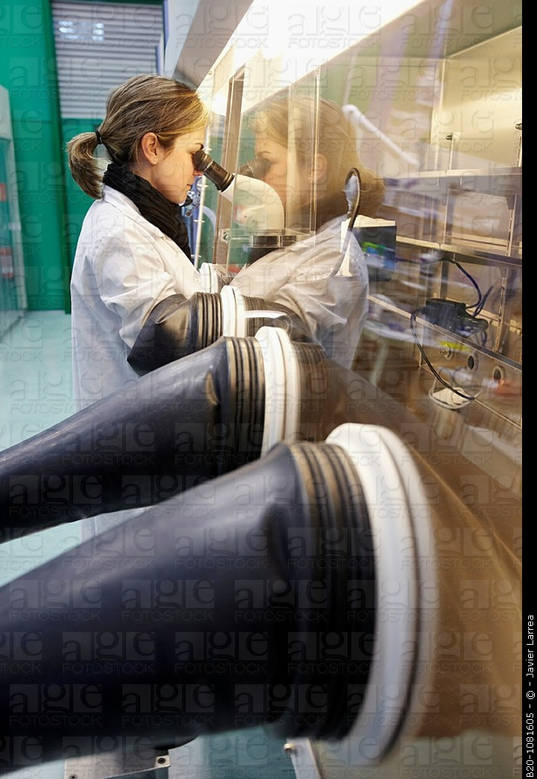
The Social Genome Data Library Privacy platform for doing safe research
Personal Data is
Delicate/Hazardous/Valuable
Important to have proper systems in place that give protection (opt out)
But allow for continued research in a safe manner (deidentified when possible)
All hazardous material need standards
Safe environments to handle them in : closed computer server system lab
Proper handling procedures : what software are allowed to run on the data
Safe containers to store them : DB system
Notes:
My vision entails the creation of several region-based facilities, The Social Genome Data Library, that will conduct population informatics the safe way.
It will provide researchers with a safe and secure platform, with opt out mechanisms,
where they can develop, integrate, manage and pursue fundamental questions on our social well being

Slide 42
WORKFLOW
Safe Platform for
Data to Decision

Slide 43
System of Access Models
Protection Usability
Restricted Controlled Monitored Open
Data Analysis Type I Analysis Type II Publish
Preparation (More sensitive data) (Less sensitive data)
More Protection More Usability
Raw Data Decision
Goal: To design an information system that can enforce the varied continuum from one end to the other such that one can balance privacy and usability as needed to turn data into decisions for a given task

Slide 44
The start …
Write up a research plan on
What data you need
What you want to do with them
Determine access levels for each data
Submit to IRB process

Slide 45
IRB: Risk of privacy violation vs. Benefit to Society
Risk of attribute disclosure
Group disclosure
Linkage attack using auxiliary information
Risk of identity disclosure
Given?
Kinds of data elements used in the study
Name/dob/cancer status/ etc… (are there $$)
What system the data resides in : HW/SW
Risk of outsiders intruding / insider attack / negligence
What can users do with the data on the system
Take data off / look at everything / only do limited queries

Slide 46
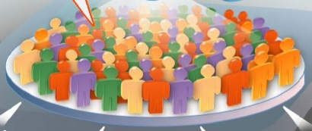
Restricted Access : Prepare the customized data
Decoupled Data (Kum 2012)
Automated Honest Broker SW
Sample selection
Attribute selection
Data integration (access to PII)
Some data cleaning
Full IRB
Example: RDC (TX census RDC)
Notes:
Need access to LOTS of data, often times include PII to prep
High risk to privacy

Slide 47
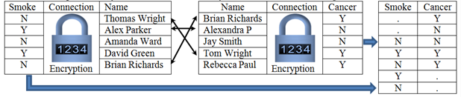
Privacy Preserving Interactive Record Linkage
Decouple data via encryption
Automated honest broker approach via computerized third party model
Chaffe to prevent group disclosure
Kum et al. 2012

Slide 48
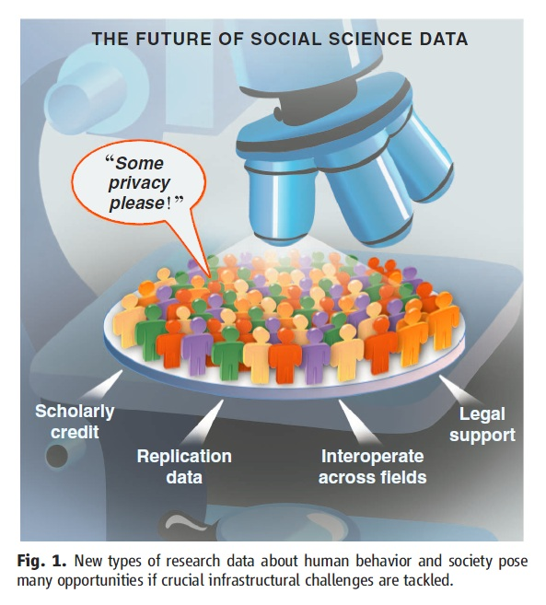
Controlled Access : Model using given tools
With approved deidentified data
Locked down VM: customized appliances
only approved software
Remote access via VPN
Very effective for threats from HBC
Full IRB
U Chicago-NORC , UNC-Tracs (CTSA), UCSD-iDASH, SAIL
Gary King. Ensuring the Data-Rich Future of the Social Sciences, Science, vol 331, 2011, pp 719-721.
Notes:
Delicate species (live, change and move as you observe), requires special handling, container (DBS) and environment (lab)

Slide 49
Monitored Access : Freely Repurpose
Information Accountability model
Exempt IRB: Explicit data use agreement (5 big Q)
Public online (crowdsource)
Any software & auxiliary data
Remote Access via VPN
Less sensitive data (e.g. Aggregate data)
SHRINE, Secure Unix servers
Gary King. Ensuring the Data-Rich Future of the Social Sciences, Science, vol 331, 2011, pp 719-721.
Notes:
Delicate species (live, change and move as you observe), requires special handling, container (DBS) and environment (lab)

Slide 50
Open Access : No restriction on use
Anyone : Publish information for others
No IRB
No monitoring use
Disclosure Limitation Methods (filter)
Sanitized data
Public websites, publications
Publish data use terms
Package with filter (disclosure limitation methods) & take out of lab
Gary King. Ensuring the Data-Rich Future of the Social Sciences, Science, vol 331, 2011, pp 719-721.
Notes:
Delicate species (live, change and move as you observe), requires special handling, container (DBS) and environment (lab)

Slide 51
Use Published Data for Good Decision Making
Protection Usability
Restricted Controlled Monitored Open
Data Analysis Type I Analysis Type II Publish
Preparation (More sensitive data) (Less sensitive data)
More Protection More Usability
Raw Data Decision
Deployed together the four data access models can provide a comprehensive system for privacy protection, balancing the risk and usability of secondary data in population informatics research

Slide 52
Privacy Protection Mechanism
Protection Usability
Restricted Controlled Monitored Open
Access | Restricted Access | Controlled Access | Monitored Access | Open Access
Protection Approach | Physical restriction to access | Lock down VM (limit what you can do on the system) | Information accountability | Disclosure Limitation
Monitoring Use | All use on & OFF the computer is monitored | All use on the computer is monitored |  | Trust
IRB | Full IRB approved | Full IRB approved | IRB Exempt (register) | Terms of Use
R1:Crypto-graphic Attack | Very Low Risk | Low Risk. Would have to break into VM | High Risk | NA
R2: Data Leakage | Very Low Risk. Memorize data and take out | Physical data leakage (Take a picture of monitor) | Electronically take data off the system.

Slide 53
Comparison of risk and usability
Protection Usability
Restricted Controlled Monitored Open
 |  | Restricted Access | Controlled Access | Monitored Access | Open Access
Usability | U1.1: Software (SW) | Only preinstalled data integration & tabulation SW. No query capacity | Requested and approved statistical software only | Any software | Any software
 | U1.2: Data | No outside data allowed But PII data | Only preapproved outside data allowed | Any data | Any data
 | U2: Access | No Remote Access | Remote Access | Remote Access | Remote Access
Risk | R1:Crypto-graphic Attack | Very Low Risk | Low Risk. Would have to break into VM. | High Risk | NA
 | R2: Data Leakage | Very Low Risk. Memorize data and take out | Physical data leakage (Take a picture of monitor) | Electronically take data off the system. | NA

Slide 54
Data privacy and confidentiality
Critical for population informatics
Data governance
Security
Ethics of data use

Slide 55
Abuse of Data
Too Often
Sufficient time is needed to give anything a proper chance and then to evaluate with data
Too Punitive (score card)
Remember goal of using data is to improve
Can back fire by becoming too conservative or short term focused
Too Rigid
Reality change over time
Data has LOTS of issues. Only an ESTIMATE

Slide 56
Conclusion
There is a lot you can do with digital data now
BUT, lots of data is not the answer
You have to learn to use data properly
You have to learn to handle data if you want to do good research using massive secondary data
Massive secondary data requires as much or more preprocessing as primary data collection
Research design, data cleaning, data preparation
Nothing replaces common sense (critical thinking) and curiosity in research

Slide 57
Notes:
Hi, my name is Hye-chung.

Slide 58
vocab
Privacy vs confidentiality
Privacy vs security

Slide 59
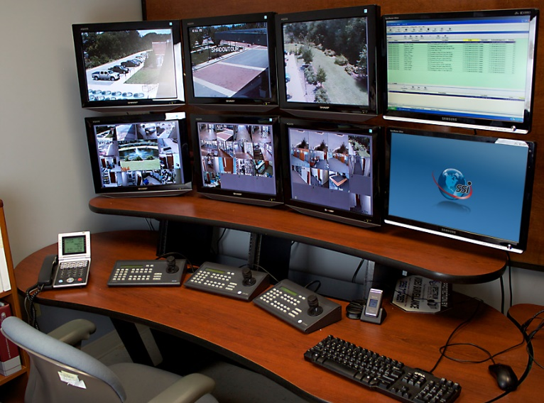

Take Away I Information Accountability Works
Secrecy : Hiding information
In reality, has limited power to protect privacy
Severe Consequences related to
Accuracy of data and decisions, use of data for
legitimate reasons, transparency & democracy
Information Accountability (Credit Report)
Very clear transparency in the use of the data
Disclosure : Declared in writing, so when something goes wrong the right people are held accountable (data use agreements)
IT WORKS! Primary method used to protect financial data
Internet : crowdsourced auditing (public access IRB)
Logs & audits : what to log, how to keep tamperproof log
D.J. Weitzner et al., Information Accountability, Comm. ACM, vol. 51, no. 6, 2008, pp. 82–87.
Notes:
First, information accountability is effective in privacy protection!
Although secrecy (limiting access) seems the instinctive method for best protection, in practice, secrecy has limited power for real protection. And yet it has severe consequences related to the accuracy of data and decisions, cost of use for legitimate purposes, as well as transparency and democracy. Many of us have experienced the difficulty of correcting a careless data entry error that has a taken weeks to fix.
In contrast, the financial sector has long been able to provide high level of protection on personal financial data, one of the most private information targeted by the most malicious cybercrimes today. Our credit history is our financial social genome which is well protected with a combination of technology and governance via information accountability.
Just as the financial sector has succeeded in providing protection through the use of secure computer software, the building of a safe environment, and increased governance and monitoring of how the data is collected and used, when social genome data libraries can take a similar approach these projects could facilitate the growth of population informatics as a revolutionary research tool to benefit our society

Slide 60
Ethical & Controlled Repository Very clear transparency in the use of the data
Riskier Data Safer Data
Protection Usability
Restricted Controlled Monitored Open
Open Access: Summary statistics (open data)
Monitored Access: Register your research plan
Controlled Access: Approval by IRB
Risk of privacy violation vs. benefit to society
Restricted Access: Link data accurately
Notes:
It will have different level of access based on the risk of harm… Safe summary data is provided as open data under open access, while more sensitive data is provided as monitored, controlled, or restricted access depending on the potential for harm in using the data.
For such a vision to become a reality, there must be a shift in our understanding of privacy protection and accountability from using sensitive data for research.

Slide 61

Take Away II Privacy is a BUDGET constrained problem
Differential Privacy proves each query leads to some privacy loss while providing some utility in terms of data analysis.
The goal is to achieve the maximum utility under a fixed privacy budget
Utility Privacy
Notes:
Second, it is important to understand that information privacy is a budget constrained problem as proven mathematically by privacy experts …that privacy and use of the data MUST be balanced.
The goal is to achieve the maximum utility under a fixed privacy budget.

Slide 62
Take Away III Privacy Expectation for Doing Research
Consider the RISK of HARM versus BENEFIT to SOCIETY
Taking into account the COST
Individual privacy
Cost of integrity of data : bad data can lead to wrong decisions
Lost opportunity cost of no access to data
Organization transparency & accountability (democracy)
Value gained through obtaining timely, accurate, appropriate information for good decision making
Financial cost of data security measures
Transparent and accountable use of data
Notes:
Finally, personal big data is freely used for many undesirable purposes today. We should distinguish between using big data for research and these other purposes. The use of personal big data for research needs to consider the actual risk of harm, benefit to society, as well as the huge lost opportunity cost of not using big data for research.
We can do this the right way with control and accountability by making the use of data very transparent.
Just as we do in the credit report system.
It is time to reap the benefits of big data by conducting research with it for the greatest social benefit.

Slide 63
Will you donate your data to find a cure for cancer?
Notes:
Many donate blood for research. Will you donate your data for research?

Slide 64
What is data science ? Hye-Chung Kum
Measurement: Smart/clever counting of real things in the digital data
Information generation: Then modeling using those measures
Delivery of information: Storytelling with data
Develop agile data pipeline for timely processing that can be iteratively updated to track the dynamic ever changing real world

Slide 65
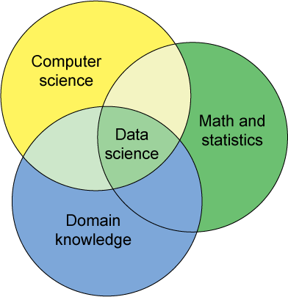
Population Informatics Research Group Data Science Teams
If you are interested in participating on a data science team, watch for opportunities
Certificate in Health Informatics?
6 additional courses

Slide 66
Agenda
What is Big Data ? What is Data Science ?
What is Population Informatics & the Social Genome ?
How is Data Science different from traditional science?
Doing research with Big Data

Slide 67
Inflation: Traditional social science vs Data Science
Consumer Price Index (CPI)
Representative basket of goods and services purchased for consumption by urban households (monthly)
This index value has been calculated every year since 1913
Bureau of Labor Statistics
Billion Prices Project : MIT
The Billion Prices Project is an academic initiative that uses prices collected from hundreds of online retailers around the world on a daily basis to conduct economic research.
Pricing Behavior, Daily Inflation and Asset Prices, Pass-Through (price and exchange rate and international rate), Green Markups (premium for green prod.)

Slide 68
What is the shape of the green line?

Slide 69
Traditional Science : Start with nothing – collect data well

Slide 70
Traditional Science : Start with nothing – collect data well

Slide 71
Data Science : Start with ALL the data

Slide 72

Noise

Slide 73

Data Science: EVERYTHING

Slide 74
First, separate out only the relevant data

Slide 75

Second, clean noise as much as possible

Slide 76
Data Science Knowledge Discovery & Data mining (KDD)
Big Data : impossible to keep organized
KDD
Clean, Merge, Reprocess
Human consumable, valid, novel, potentially useful,
and ultimately understandable information
Analytic dataset

Slide 77
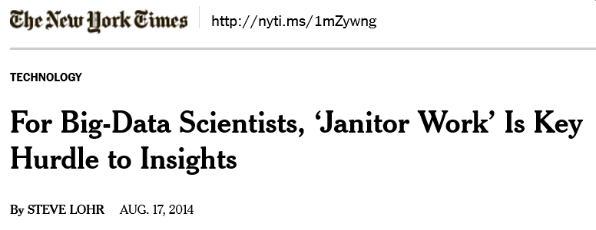
Data Wrangling
Data Wrangling is a term that is applied to activities that make data more usable by changing their form but not their meaning
reformatting data: MDY vs YMD
mapping data from one data model to another: ICD9 vs CPT code
and/or converting data into more consumable forms: to graphs
30-80% of the work in using big data
Once raw data is “wrangled” into the correct analytic data
Running statistics models are fairly simple and similar to what you do traditionally
There are new methods but, usually requires a LOT of data

Slide 78
Tools for data wrangling
Reusable code
SAS macros, stata & R: user defined
Write your own
Download others: Read others and modify
Per data, accumulate custom tools for the data
Keep it organized so you can find it when you need it
Keep it general enough so it can be used more widely
Learn basic
Programming concepts: loops, conditionals, flow diagram
Software Engineering

Slide 79
Third: Model

Slide 80
Fourth: Validate to avoid overfitting
Model
Validate

Slide 81
Validation
Training Data
If you have enough data random partition into train/validate/test
If you do not have enough data
Cross validation
Gives confidence to the results when p-value has little meaning
Validate Data
Test Data

Slide 82
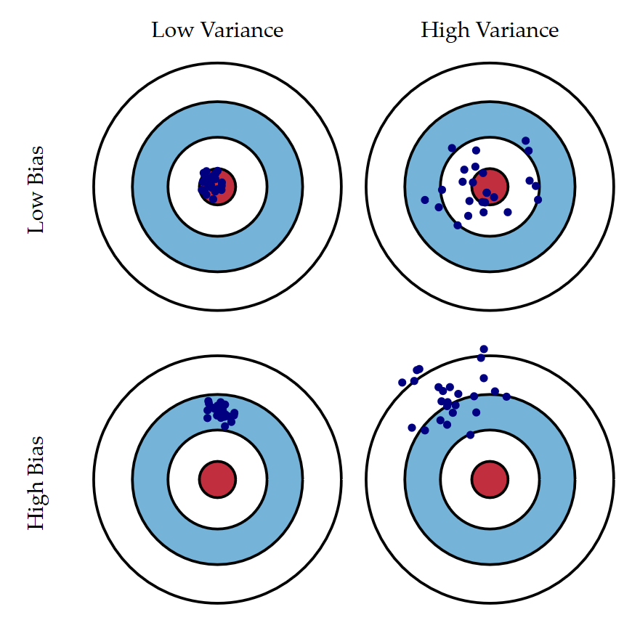
Bias and Variance http://scott.fortmann-roe.com/docs/BiasVariance.html

Slide 83

Validation http://scott.fortmann-roe.com/docs/BiasVariance.html
Under fitting
Over fitting

Slide 84
Sometimes models differ between the two approaches. Why ?
Traditional Science Model
Validated from
Data Science Model

Slide 85
Comparison
 | Traditional Science | Data Science
Common | Use statistics to model from the data points (number of data does matter)
Focus | Usually more about causation | STRONG correlation
Measurement | Mostly Based on theory (deductive) decide what to measure - green only With out seeing the other colors Slow iterative process to discovery | Iterate between deductive (theory based top down) and inductive (data based bottom up) reasoning to figure out what to measure : can see the other colors, so use existing data to compare Different from fishing for results or atheoretical Faster iteration to discovery
Measurement Error | Reduce/minimize by designing experiments well | Know what it is, adjust for it as best as possible. Usually use data that exist
Bias | Random Points, oversampling | Validation is very important: be careful not to over fit to the data, Know the bias
Main issue | Are there enough points to get the full picture? | Is the data clean enough? Is the data representative ? Sensitivity analysis

Slide 86
Notes:
Hi, my name is Hye-chung.

Slide 87
Take away in Data Science and Statistics
Both are about understanding/developing general models from many data points (variance & bias). The critical part is good measurement.
Notes:
Hi, my name is Hye-chung.

Slide 88
Take away in Data Science and Statistics
Statistics: Hypothesis driven
Data Science: Iterate between deductive (theory based top down) and inductive reasoning (data based bottom up).
MUST validate. Sensitivity analysis is important
Notes:
Hi, my name is Hye-chung.

Slide 89
Take away in Data Science and Statistics
Use data science first to develop analytic data sets from secondary data
Then use statistics to run traditional models (causation) OR
more descriptive models (correlation)
Notes:
Hi, my name is Hye-chung.

Slide 90
Agenda
What is Big Data ? What is Data Science ?
What is Population Informatics & the Social Genome ?
How is Data Science different from traditional science?
Conclusion: Doing research with Big Data

Slide 91
Scientific Process: Traditional
One research project: one cycle
Iteratively build on prior work : spiral - SLOW
Theory
Development
Inductive
Model
Deductive
Model
Empirical
Data
Minor iterations
Pilot / pretest Data

Slide 92
Scientific Process: Data Science
Theory
Development
One research project: numerous cycles
Iteratively refine question until satisfied: spiral – FAST progress
Agile & accurate movement around the data
Final answer
if required data exist: Data Science
if need to collect new data: Traditional Science
If possible validate via Traditional Science
Use data science to figure out which question should be studied in depth
Inductive
Model
Deductive
Model
Empirical
Data

Slide 93
Big Data Modeling
NLP: natural language processing (java)
Medical notes
Social network
Iterative:
Hill Climbing: random start
Local vs global max
Convergence: converged enough
Predictive modeling
Model drift over time
Machine learning
SVM : support vector machine
Boundary cases
Kernel: transform high dimensional space
Hadoop / map-reduce
Parallel processing

Slide 94
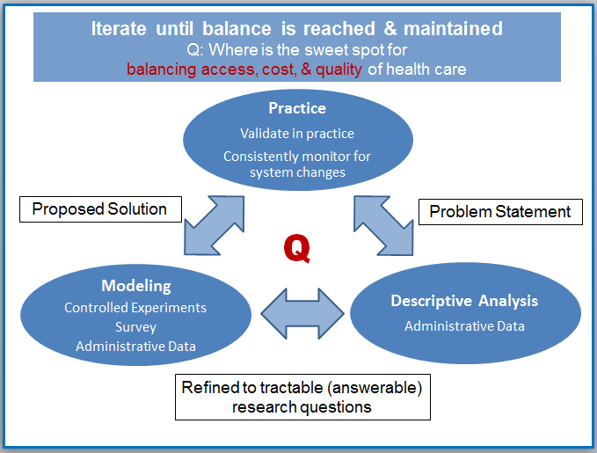
Learning Hospital
Integrating practice and research
Big Data
Data Science
A data-driven organization acquires, processes, and leverages data in a timely fashion to create efficiencies, iterate on and develop new products, services, and navigate the competitive landscape.
Data Science
Data Science
And / Or
Traditional Science

Slide 95
Thank you! Questions?
Population Informatics Research Group
http://research.tamhsc.edu/pinformatics/
http://pinformatics.web.unc.edu/
Notes:
Hi, my name is Hye-chung.

Slide 96
Practical Example
Self Evaluation

Slide 97
Traditional evaluation
Client
Families
Children
Intervention
Evaluation
Notes:
One time post evaluation by an objective third party

Slide 98
Traditional evaluation
Hallmark: Detachment of the evaluator from policymakers and program managers
Evaluation becomes adversarial
Can become ill-informed due to the lack of communication between evaluators and staff
Scientific objectivity : results in tasks being defined in such narrow terms that their contribution to informed policy debate is minimized
Notes:
(between evaluators and policymakers and program staff),
ultimately may be of little benefit

Slide 99
Alternative : Self Evaluation
SET : Self Evaluation
Client
Families
Children
Intervention
Outcome Goal
Indicator 1
Indicator 2
is a form of empowerment evaluation
that is collaborative and participatory
an ongoing process
as long at it is technically strong, a viable alternative
Notes:
Team of local stake holders

Slide 100
Self-evaluation : who ?
SET (self-evaluation team)
a team of diverse people
gathered locally for their expertise
Should involve stake holders
evaluators may work for an independent organization
or be employed by the agency administering the program

Slide 101
Guilford County : Leading By Results
Goal : At-risk children and families should be safe and healthy in stable environments
Indicator 1: We will decrease the rate of children placed away from their home from 7% in FY 2003 to 5% by the end of FY 2005.
Indicator 2: We will decrease the rate of children entering foster care who are initially placed in shelter or group home care from 13% to 11% by the end of FY 2005.
Indicator 3: We will reduce the rate of children re-entering care from 10% in FY 2003 to 8% by the end of FY 2005.
Indicator 4: We will reduce the number of children in care with four or more placement moves from 14% in FY 2003 to 12% by the end of FY 2005.
Indicator 5: We will maintain the percent of children substantiated/in need of services that are not repeat victims of substantiated maltreatment at 92% by the end of FY 2005.
Indicator 6: We will continue to work on addressing disparities associated with race/ethnicity as evidenced by a decrease in the percentage of African American children in care from 57% by the end of FY 2005.
Notes:
initative

Slide 102
Things to watch out for in self-evaluation
Outcomes is only one part of the picture
You have to monitor process
You have to pay attention to context
Don’t lose sight of the forest
Remember one indicator is just a tree
Balance changes to the intervention with solid research

Slide 103
Key ingredients for self-evaluation
Outcomes for clients are clearly defined and disseminated throughout the agency
It is a collaborative process that brings together individuals with different kinds of expertise to discuss the data used to measure outcomes and agency processes
It is an ongoing process with regular meetings to discuss agency status on outcomes
It requires timely and accessible data that appropriately measure outcomes and other indicators of interest
It should include ongoing attention to implementation progress of the core strategies to improve the outcomes
It requires technical expertise to ensure defensibility and adaptability

Slide 104
Key ingredients for self-evaluation
Outcomes for clients are clearly defined and disseminated throughout the agency
It is a collaborative process that brings together individuals with different kinds of expertise to discuss the data used to measure outcomes and agency processes
It is an ongoing process with regular meetings to discuss agency status on outcomes
It requires timely and accessible data that appropriately measured outcomes and other indicators of interest
It should include ongoing attention to implementation progress of the core strategies to improve the outcomes.
It requires technical expertise to ensure defensibility and adaptability
KDD Technology

Slide 105
Self Evaluation and KDD
as long at it is technically strong
Usually requires technical assistance
Outcomes data analysis
Knowledge Discovery and Datamining (KDD)
Usher, C. L., Wildfire, J. & Schneider, S. (2001)
Usher, C.L. (1995)

Slide 106
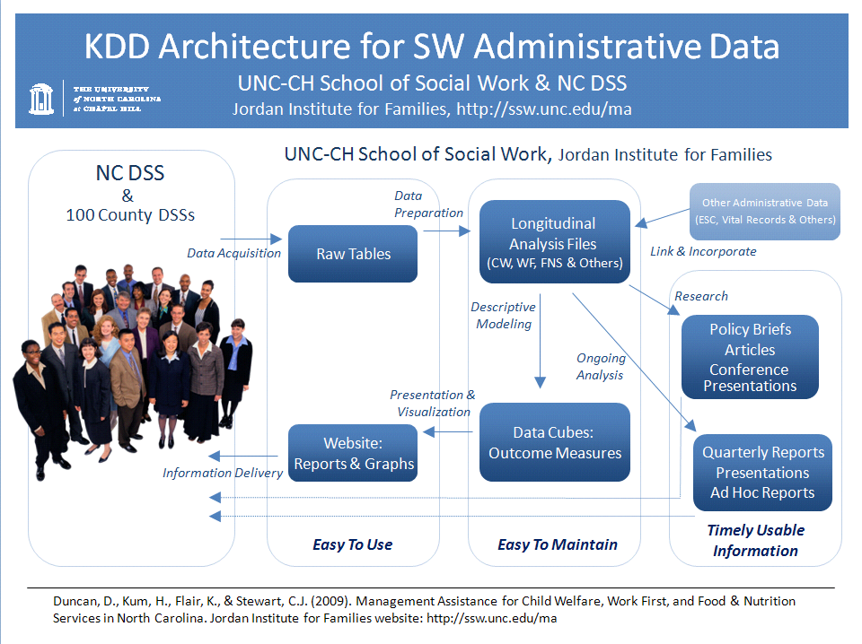
Data Infrastructure
Data Center
Data mining
Website
Reports & Graphs
http://ssw.unc.edu/ma
Notes:
Research is CS tends to focus on the various algorithms for the data mining step in the full KDD cycle
My project is more applied and tends to work with all aspects of the cycle

Slide 107
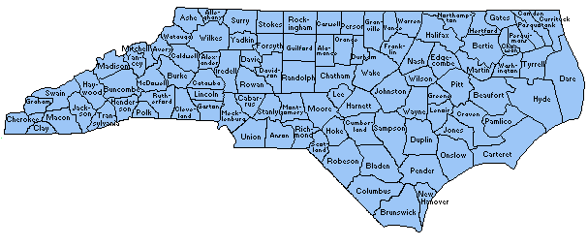
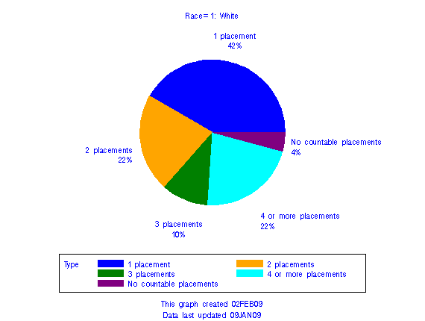
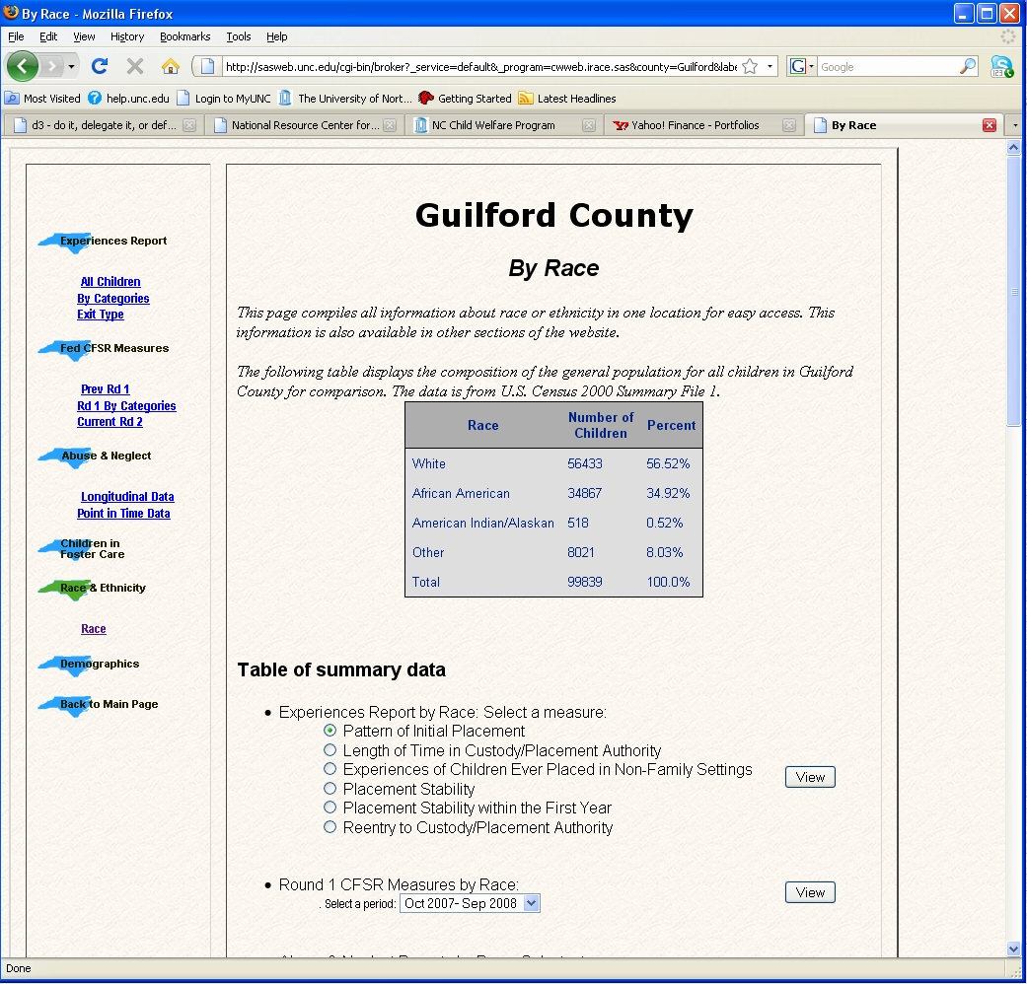
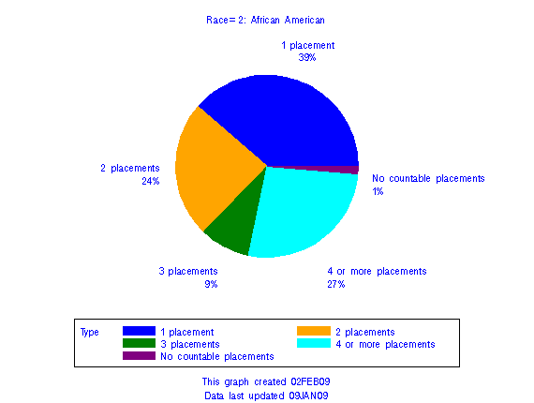
Placement Stability for SFY03_04 Cohort
In Guilford County by Race

Slide 108
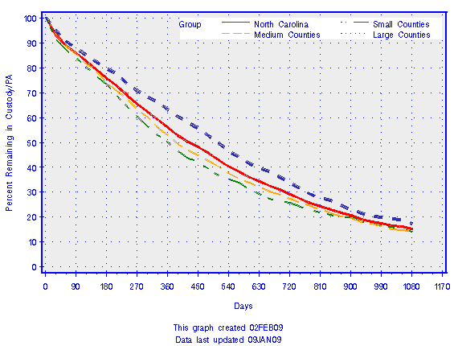
Explanation for this Chart
This chart depicts how many days children spent in their first Custody/Placement Authority. Where the line crosses the 50 percent line, half of the children in that cohort are no longer in custody. Length of stay is a longstanding concern regarding children’s experiences in out-of-home care …
Rate of Leavaing Custody for the Children in SFY05_06 Cohort for North Carolina

Slide 109
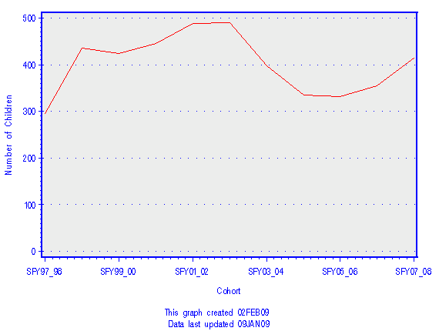
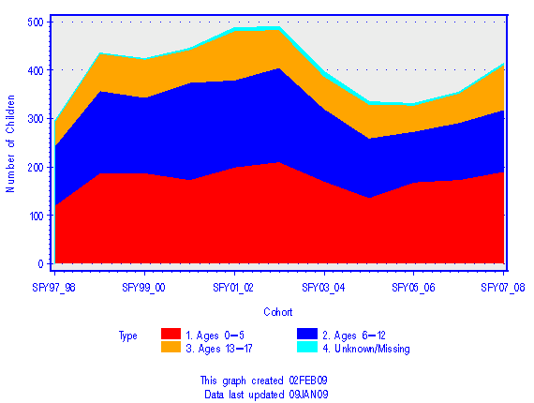
Reports of Abuse and Neglect
In Chatham County
Unique Number of Children
by First Ever Report Cohort
Reports of Abuse and Neglect by Age
In Chatham County
Unique Number of Children
by First Ever Report Cohort

Slide 110
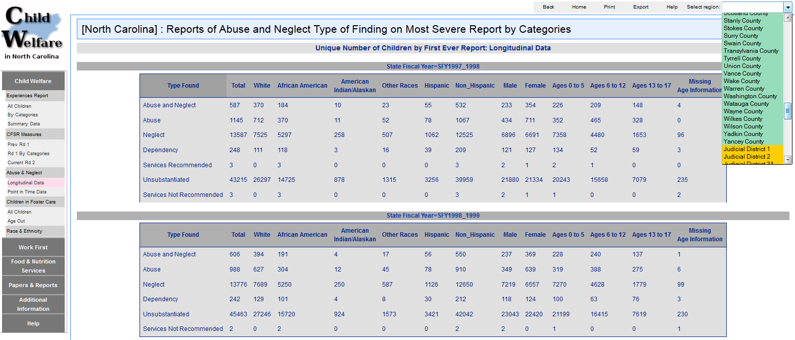

Slide 111
Research
Barth, R. P., Duncan, D. F., Hodorowicz, M.T., and Kum, H.C., Felonious Arrests of Former Foster Care and TANF-Involved Youth, Journal of the Society for Social Work and Research, 1:pp 104-123, 2010.
Kum, H. C., Barth, R., Stewart, C. J., Lee, C. K. (2012). Coming of Age: Employment Outcomes for Youth Who Age Out of Foster Care Through Their Middle to Late Twenties.
Kum, H.C., Duncan, D.F., & Stewart, C. J., Supporting Self-Evaluation in Local Government via KDD, Government Information Quarterly: Building the Next-Generation Digital Government Infrastructures, 26(2):pp 295-304, April 2009.
Various state reports
09 North Carolina’s Children’s Index, Action for Children
BTC (NC Budget & Tax Center) Brief, NC Justice Center
BTC (NC Budget & Tax Center) Brief, NC Justice Center

Slide 112
KDD system
Easy to use and maintain
Timely information
Difficulties :counting!
What to measure? How to measure?
Measure child maltreatment in county ?
When you have a solid count of important things, easy to apply sophisticated statistics on the count
IT Difficulties
Project management : testing, help pages
Data management

Slide 113
Lessons : common sense counting
What to count?
What is the context (denominator)?
Understand exactly what you have
What is the unit of rows
What is being counted in variables (columns)
ALWAYS check for face validity of counts
Data that is not used goes bad
Cross check whenever you can
Sensitivity analysis
Look at your data

Slide 114
Video
http://research.tamhsc.edu/pinformatics/data-science/

Slide 115
International Population Health Informatics Research
US : LEHD (Census Bureau) – 2010 Nobel Prize in economics
Australia & New Zealand
National Centre for Epidemiology and Population Health (NCEPH), The Australian National University
Australian Institute of Health and Welfare
Centre for Health Record Linkage
Centre for the Study of Assessment and Prioritisation in Health, School of Medicine and Health Science (NZ)
EU
Health Information Research Unit, School of Medicine, Swansea University, Wales, UK
Health Services Research Unit, University of Aberdeen, Scotland
Canada
Canadian Institute for Health Information
Child and Youth Data Lab, Alberta Centre for Child, Family and Community Research

Slide 116
Take away: What is Data Science ?
4 Vs of Big Data
Volume : lots of data
Velocity : constantly generating & changing
Variety : expressed in many ways
Veracity : lots of errors
(Value)
Time
Money
Quality (Precision)
AMP
Algorithm
Machine
People
Notes:
Hi, my name is Hye-chung.

Slide 117
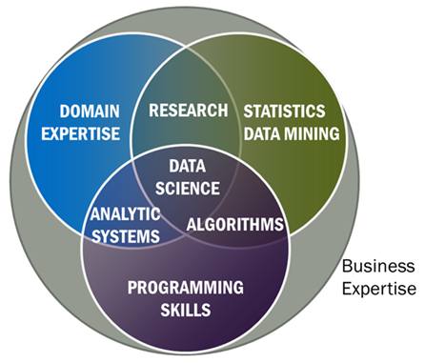
Take away: What is Data Science ?
Data Science is a team science: Need to know enough to communicate with statisticians and domain scientists
Notes:
Hi, my name is Hye-chung.

Slide 118
Take away: What is Data Science ?
The most important skill or trait in a data scientists
Intense curiosity: “a desire to go beyond the surface of a problem, find the question at its heart, and distill them into a very clear set of hypothesis that can be tested”
Notes:
Hi, my name is Hye-chung.

Slide 119
Social Genome: Putting Big Data to Work to Advance Society
Hye-Chung Kum
Texas A&M Health Science Center, Dept. of Health Policy & Management
University of North Carolina at Chapel Hill, Dept. of Computer Science
(kum@tamhsc.edu)
http://research.tamhsc.edu/pinformatics
Notes:
Hi, my name is Hye-chung.

